Slide 1
CSE 170 Technical Teamwork Fall 2024
Making you awesome – so you can be a better teammate.

Slide 2
Opening Prayer

Slide 3


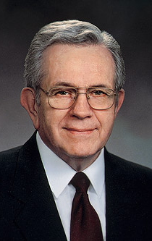

Spiritual Thought
In mortality, we are like actors who enter a theater just as the curtain goes up on the second act. We have missed act 1. [..]
‘And they all lived happily ever after’ is never written into the second act. That line belongs in the third act, when the mysteries are solved and everything is put right.

Slide 4

Agenda
Self-Awareness
Team Formation Activities
Review assignments and due dates
Initial the roll
Assignments
Personal User Manual Team Activity

Slide 5

Assignments
U02 Prove: User Manual
Create your own personal user manual to increase self-awareness
This Photo by Unknown Author is licensed under CC BY-SA

Slide 6
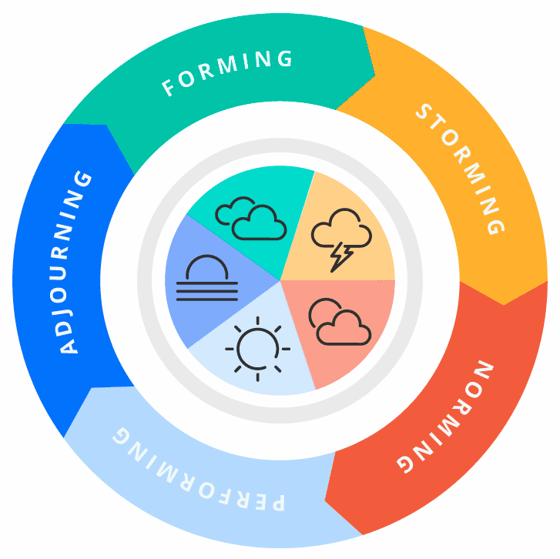
Team Formation Basics
Forming
Team members gather and get to know each other.
Storming
Team members are learning each other’s strengths and weaknesses.
Norming
Team members have started understanding each other well.
Performing
Team members have optimized the way they work.
Adjourning
The team disbands, moving to other projects or other semesters.
Working together is becoming easier.
Some friction may occur.
Enthusiasm and excitement are present!
Members are able to work quickly and productively together.
This may be a time of sadness for well-functioning teams.

Slide 7


Ice Breaker – Two Truths and a Lie!
This Photo by Unknown Author is licensed under CC BY-SA

Slide 8


Slide 9

Personal User Manual Project
A “personal user manual” is a collection of statements the explain how you operate, which drives you and what is difficult for you.
This is meant as an easy way to communicate with co-workers about your needs.
The assignment is to create a slide deck that covers all the ground you think is important to understanding you as a co-worker.
This Photo by Unknown Author is licensed under CC BY-ND

Slide 10
User Manual Group Activity
Each of you download the PowerPoint template from the assignment.
Put your individual name on slide 2.
Starting on Slide 3, work as a group to answer each of the questions up through slide 11.
Remember conversational turn-taking.
Time permitting – do slide 12 as well and have some fun with it!
Slides 13-14 you can do on your own

Slide 11



Next Time
Self-Management

